Slide 1
Feature Analysis for Classification of Physical Actions Using Surface EMG Data
Presented by:
Manan Singal
Vaibhav Sobti
Disha Katia
Keshvi Tomer
Srijan Singh

Slide 2
BACKGROUND
Need to develop better ways for therapeutic rehabilitation of physical disabled than the ones we currently provide
Design an engineering solution is to sense the required myoelectric signal, assuming the signal has a causal relation to the intended motion, using an EMG sensor on the muscle surface and extracting the relevant information.
There is a need to design and develop a suitable Pattern recognition Algorithm and the hardware to cope up with the complexity of human system and adapt to uncertain environment.

Slide 3
OBJECTIVE
Recording biological EMG signals from individuals
Analysis of useful features followed by their extraction from the signal data.
Classification of Data
Analysis of the features

Slide 4

Physical Action Dataset
The data-set we have worked on has been obtained from the UCI Machine Learning Repository (2013)
It comprises of recorded EMG data of 4 subjects, while they performed 20 different physical activities.
8 EMG electrodes were placed on each subject, 4 on the biceps and triceps, next 4 on thighs and hamstring muscle.
Each channel consists of approximately 10,000 values.

Slide 5
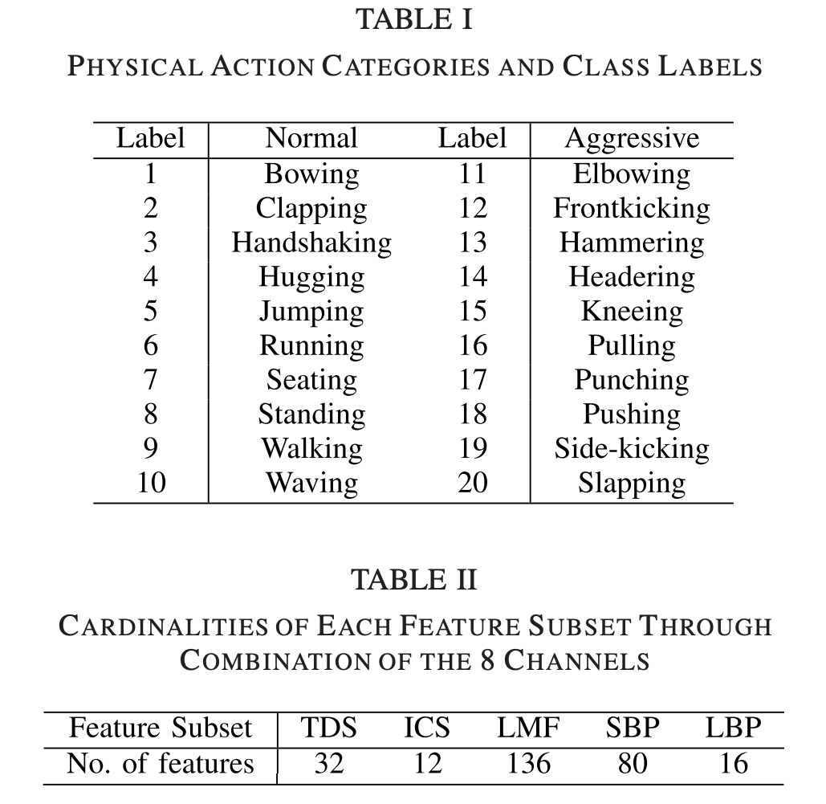
PHYSICAL ACTION CATEGORIES AND CLASS LABELS

Slide 6
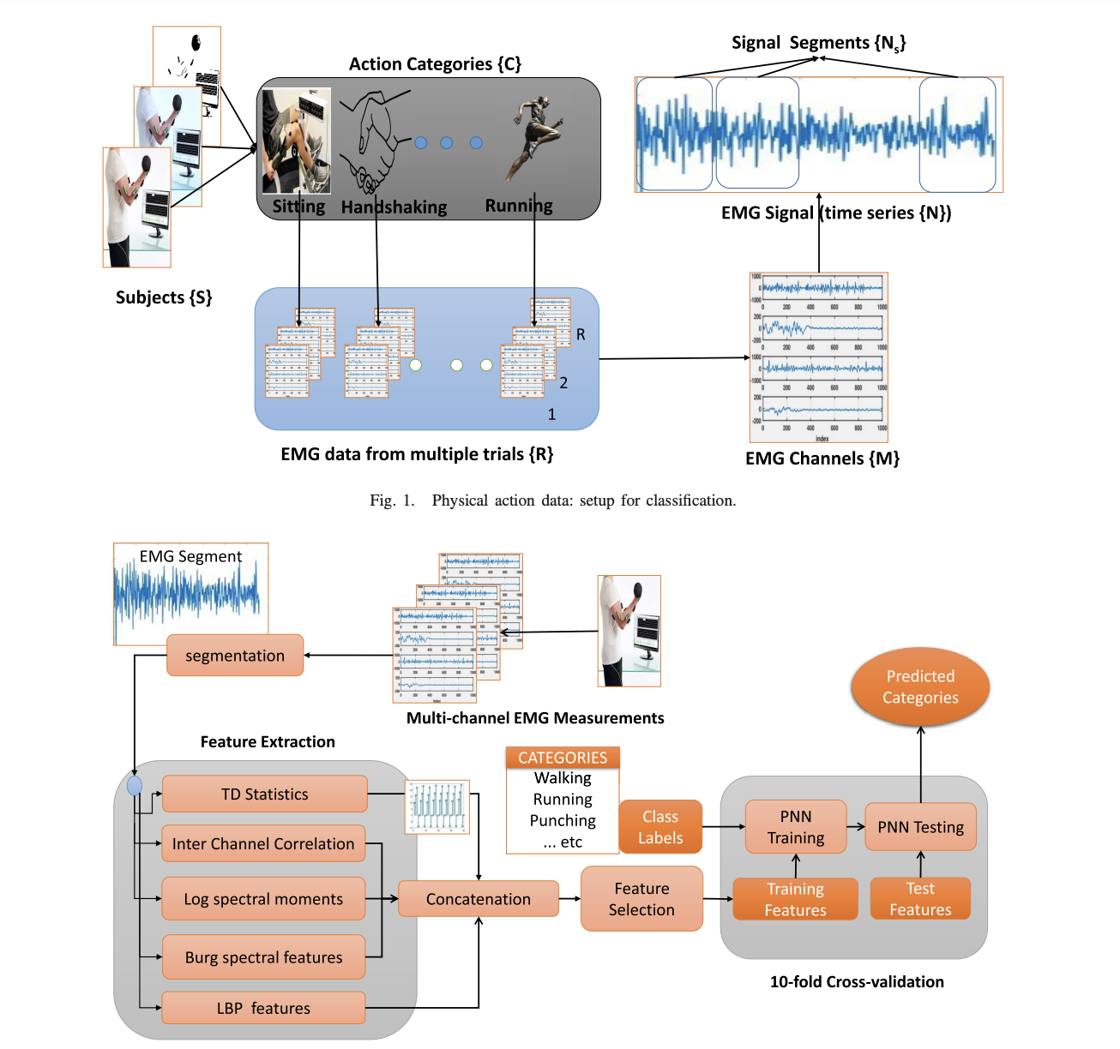
METHODOLOGY

Slide 7
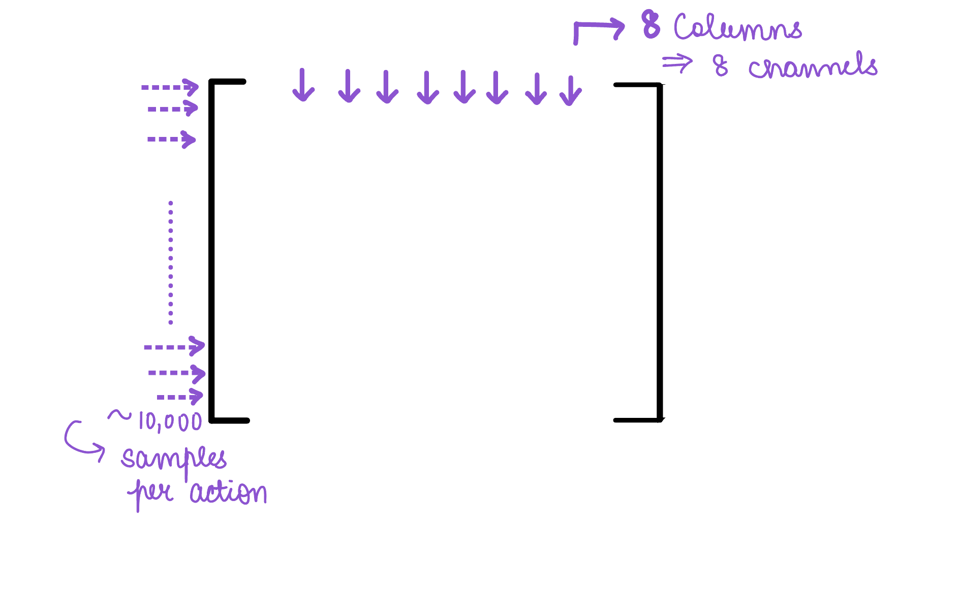
ANALYSIS OF THE DATASET
The Dataset consisted of 80 files corresponding to 20 actions by each subject
Each file contained a ~10,000 x 8 matrix

Slide 8
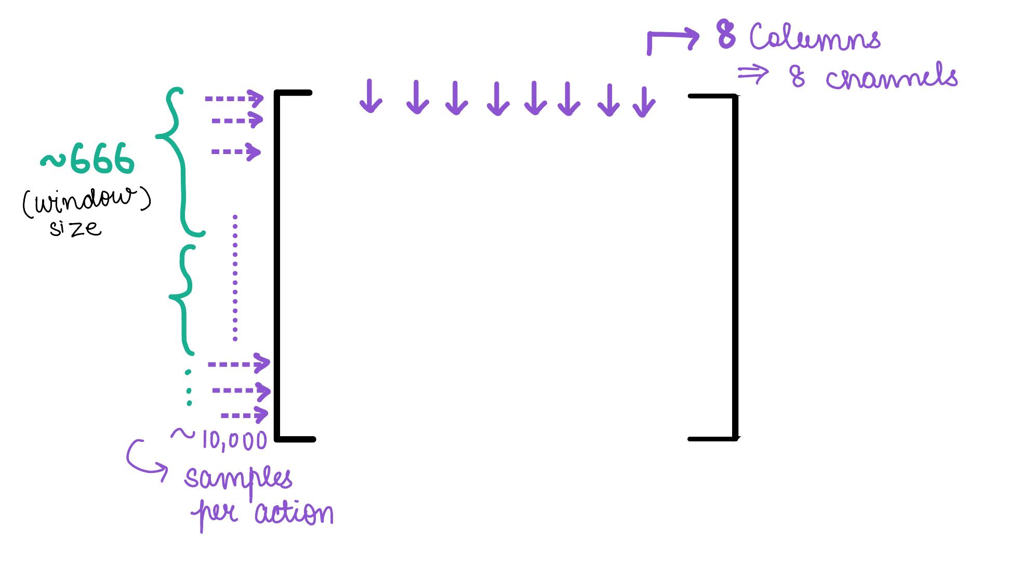
Windowing
We have used non-overlapping sliding window of ~666 samples each
For a total of 10,000 samples, we get 15 windows: 1 window per trial

Slide 9
Feature Extraction
Extracted features:
Time domain Statistics: mean, variance, skewness, kurtosis
Inter- channel statistics
Log moments of Fourier Spectra
Spectral Band powers
Local Binary Patterns

Slide 10
Time Domain Statistics
We have computed the mean value per window per channel per action per subject as follows:
First order mean
Second order mean: Variance
Third order mean: Skewness
Fourth order mean: Kurtosis
Total 32 features obtained

Slide 11
Inter-channel statistics
Computed the covariance of channels taken two at a time
The covariance of the bicep and tricep channels were computed separate from the thighs
Total 12 features obtained

Slide 12
Log moments of Fourier spectra
The logarithms of moments and their ratios from the frequency domain are computed for the EMG segments.
L-point fourier transform was computed
Pair-wise features based on moment products were found
Total 136 features obtained

Slide 13
Spectral Band Power
To compute the spectral band power, we consider an auto-regressive model
We have made a 10th order approximation and calculated the spectral band power using burg's method
Total 80 features obtained

Slide 14
Local Binary Patterns
We have further divided each of our 15 windows to windows of 5 samples each
We then calculated the local mean of these samples and checked relatively if each sample is above the local mean or below it marking them as 1 and 0 respectively to obtain a binary pattern for each sub-window
Total 16 features were obtained

Slide 15
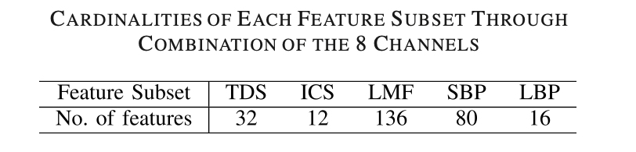
Obtained matrices for features

Slide 16
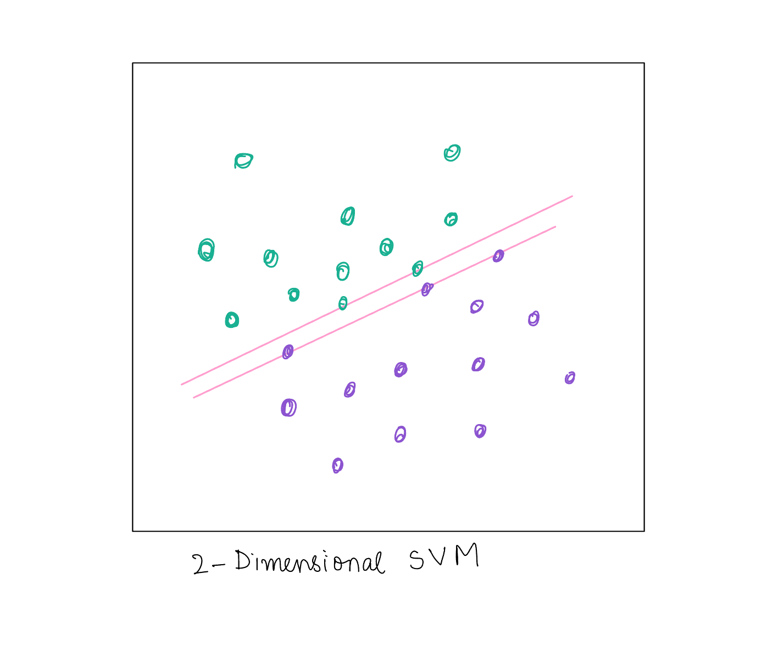
Classifier: Support Vector Machine (SVM)

Slide 17
Results and Accuracy:
Using SVM classifier we have input a feature matrix and class matrix and have made a model
We have trained the model on 75% of the data-set and tested it on the remaining 25%.
We have achieved an accuracy of 65% using this model
Link to code: Feature Extraction and Analysis

Slide 18
Work done from our end
We have implemented the given paper to obtain results as follows:
Separation and labeling of data according to the classes
Windowing of samples
Extraction of a total of 276 features from the given data
Training Support Vector Machine using the feature set and class matrix
Testing the model for its accuracy

Slide 19
FUTURE PROSPECTS

